Slide 1

Computer Graphics
Course Code: CSC4118
Fall Semester 2023-24
Project Presentation
Modern Urban Vista
Under the Guidance of
Rahul Biswas
Lecturer
Department of Computer Science, FST
Submitted By:
Md. Omar Faruk Sakib
21-45077-2

Slide 2
Introduction & Motivation
Technological Innovation
Artistic Expression and Aesthetics
Realism and Immersion
User Engagement and Exploration
Educational Value
Reflecting Modern Urban Dynamics
Innovation in Multimedia Experience

Slide 3
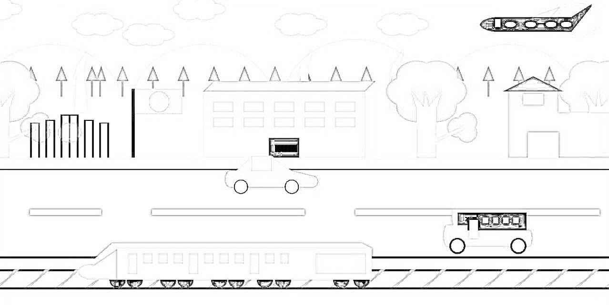
Diagram

Slide 4
List of Objects & Functions to Represent Objects
Sun
Clouds
Hills
Trees
Buildings
Vehicles
Human figures
Flag
Shaheed Minar
Windmills
College building
House
Road
Ground
Rail line

Slide 5
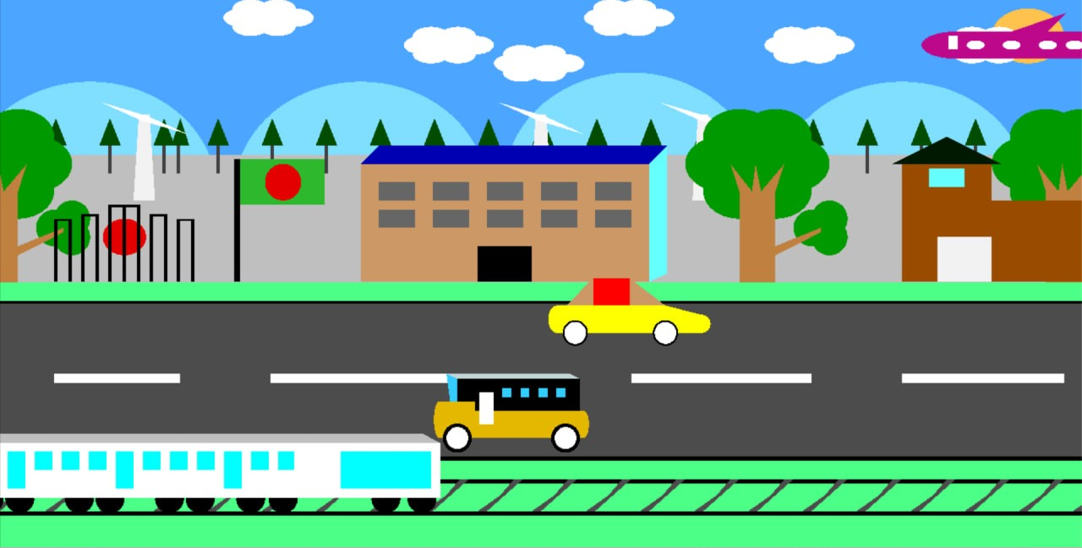
Output Of Screenshot

Slide 6
Uniqueness of the Project
Realistic Urban Representation
Interactivity
Educational Value

Slide 7
Conclusion & Future Work
The "Modern Urban Vista" project successfully creates an immersive urban landscape through OpenGL and graphics programming. Interactive features, attention to detail, and symbolic elements contribute to its uniqueness. Future work includes advanced interactive features, shader programming for enhanced visuals, educational modules, and optimization for varied platforms, aiming for a more dynamic and accessible experience.

Slide 8
References
https://www.opengl.org
https://virtual-graph-paper.com/
https://www.glprogramming.com/red/chapter01.html

Slide 9
Thank You

